Slide 1
LECTURE 23
Inheritance Basics
Types of Inheritance (Simple , Multi-Level , Multiple and Hierarchal )

Slide 2
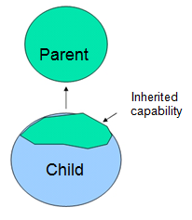
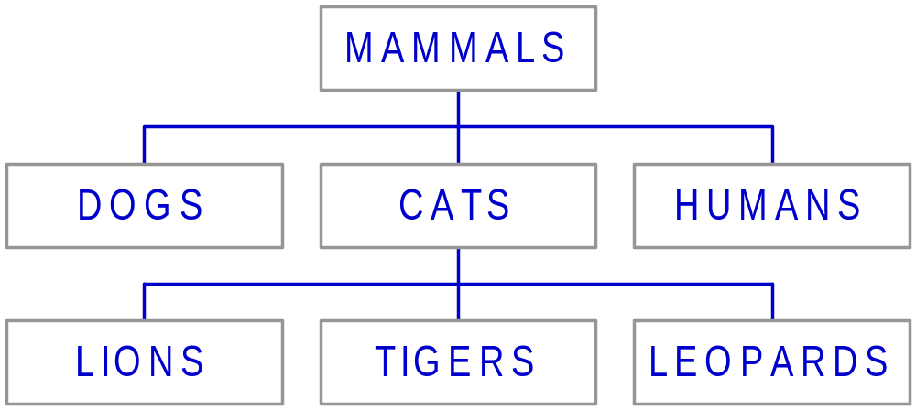
Definition
This mechanism of deriving a new class from existing/old class is called “inheritance”.
The old class is known as “base” class, “super” class or “parent” class”
The new class is known as “sub” class “derived” class, or “child”
class.
Example:

Slide 3
Inheritance: Introduction
Reusability--building new components by utilizing existing components- is yet another important aspect of OO paradigm.
It is always good/ “productive” if we are able to reuse something that is already exists rather than creating the same all over again.
This is achieve by creating new classes, reusing the properties of existing classes.
It saves money , time etc.
To use a class that is already created and tested properly saves the effort of testing and developing same again.
In C++ one class is tested and adapted properly can be used by the programmers to suit there requirements.

Slide 4
Define a Class Hierarchy
Syntax:
class DerivedClassName : access-level BaseClassName
where
  access-level specifies the type of derivation
    private by default, or
    public
Any class can serve as a base class
  Thus a derived class can also be a base class

Slide 5
Implementing Inheritance in C++ by Deriving Classes From the Base Class
Syntax:
class <base_class>
{
…
};
class <derived_class> : <access-specifier>
<base_class>
{
...
};

Slide 6
What to inherit?
In principle, every member of a base class is inherited by a derived class
  just with different access permission
However, there are exceptions for
  constructor and destructor
  operator=() member
  friends
Since all these functions are class-specific

Slide 7
Access specifiers of derivation
  The public access specifier
  The protected access specifier
  The private access specifier
Sequence of invoking constructors and destructors
  Constructors are called in the order of Base – to – Derived
  Destructors are called in the order of Derived – to – Base

Slide 8
FORMS OF INHERITANCE

Slide 9
Single Inheritance
Multi-level Inheritance
Hierarchical Inheritance
Multiple Inheritance

Slide 10

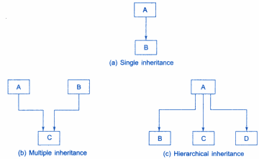
Object-Oriented Programming Using C++, Third Edition

Slide 11
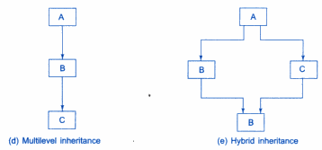

Slide 12
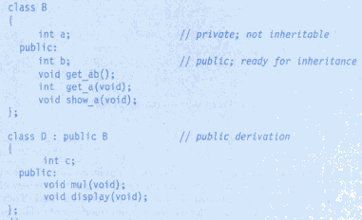
EXAMPLE OF SINGLE

